Slide 1
Heroes or Villains? A digital preservation Rogues gallery
Andrea K. Byrne
Ross Spencer

Slide 2
A digital collection
Ideal: All files are sentenced and there are no technical difficulties
Reality: Some files are sentenced, and some files have technical difficulties
A large number of the some are difficult to isolate and look at…

Slide 3
What can we do? The easiest to look at are the ones with technical difficulties, and some poorly sentenced, e.g. leveraging GDA7…

Slide 4
Examples
We can isolate (standard DROID issues):
Files for which we don’t know the format
Files that are not cleanly identified (multiple-IDs)
Duplicate files
File names with odd character encodings
We an also isolate (using OUR OWN rules):
Specific file formats using PUID (Thumbs.db)
Specific filenames and file paths

Slide 5
Art of the Archivist
To make a working copy of our files
To never work on the original masters
Even directly before ingest, our ingest candidates will be a brand new copy created from the masters for pre-conditioning…

Slide 6
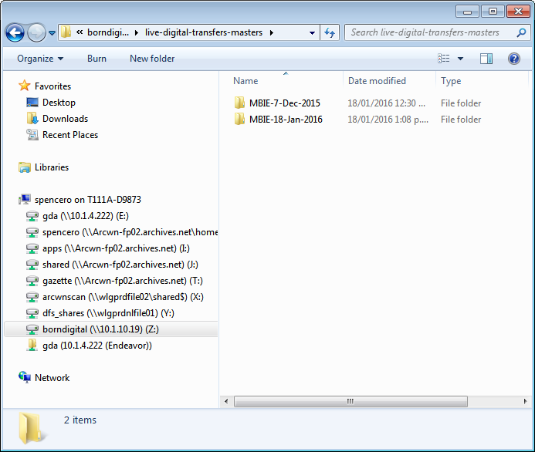
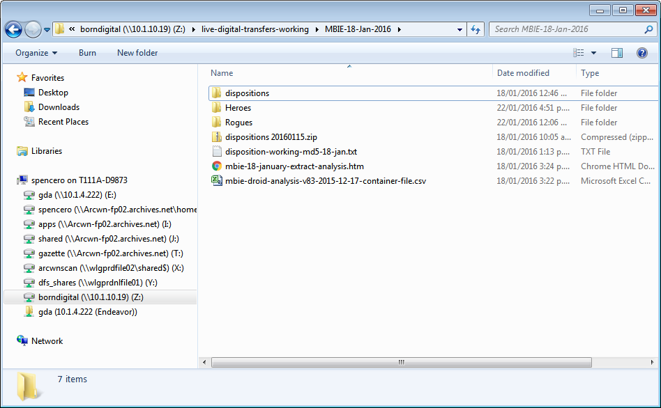
Art of the Archivist
Live transfer pilot working folders configuration:
Masters Folder – reference folder only
Working Folder:
*Dispositions (complete agency extract)
* Heroes and Rogues isolated

Slide 7
Rsync!
Using our friend Rsync, we can create copies easily:
sudo rsync -lptDv --files-from=opf-rogues-list.txt “/home/masters/digital-transfer/” “/home/rogues/digital-transfer/”
-l copy symlinks as symlinks
-p preserve permissions
-t preserve modification times
-D preserve device/special files
-v increase verbosity
Rsync does have an –archive command. This can often cause the last-accessed date to be modified because of the process used to preserve additional metadata…

Slide 8
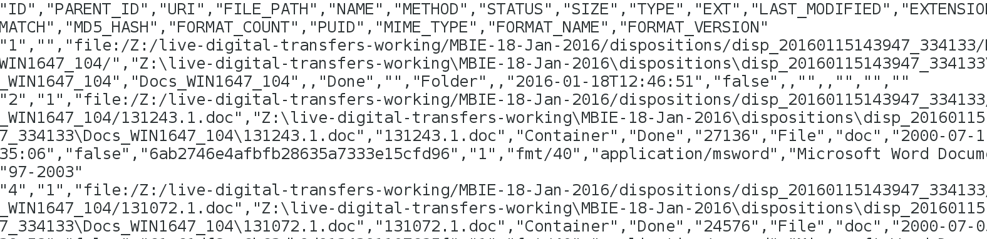
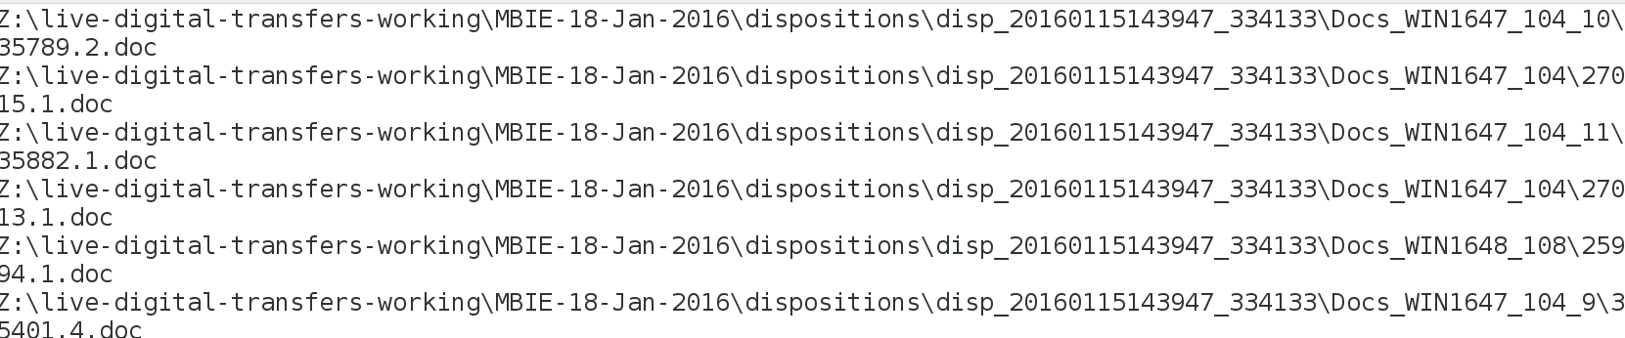
Rsync can take a list of files as input
Which we realised could make the concept of a rogues gallery a) convenient b) a reality
Our input comes from the DROID analysis report:
Narrowed down into a list of filenames:

Slide 9
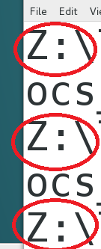
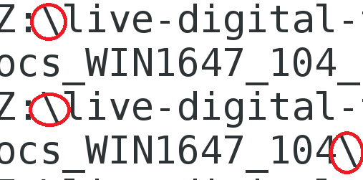
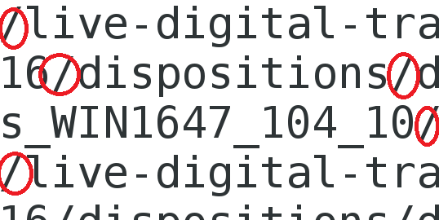
But the list isn’t perfect yet!
First: the directory’s location is different:
Second: The slashes are ‘wrong’:
vs.

Slide 10

How can we fix this?
A few methods
eg. find and replace in a text editor like notepad ++
I prefer sed -
Stream editor
Linux tool for
Filtering &
Transforming text

Slide 11
WHATCHA SED???
sed 's/Z://;s/\\/\//g' input.csv > output.csv
sed = calling the command
s = substitute
/Z: = pattern to change
// = pattern to change it too
; = second argument
/\\ = backslash with escape character
/\// = forward slash with escape character
g = change every place this pattern is found
> = pipe out of file with edits to a new file, otherwise, the edits are just printed on the screen.

Slide 12
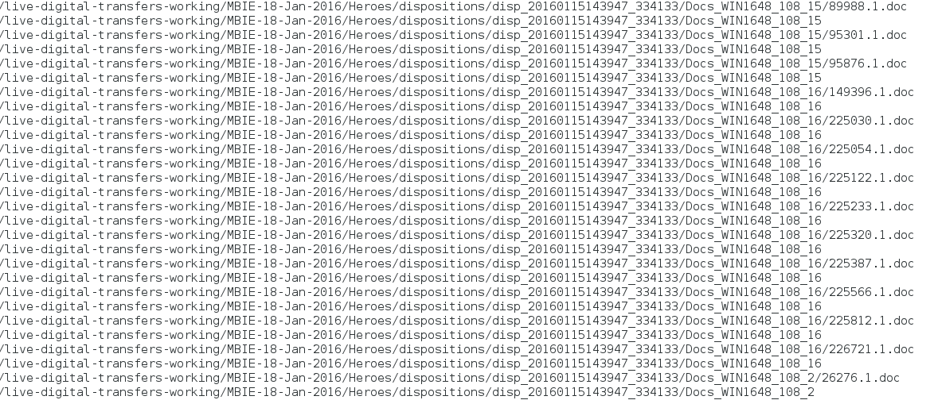
Now Rsync!
Rsync reads the lists of files, and copies the business classification scheme (BCS) and JUST ROGUE FILES into the new location:

Slide 13
A Helpful(?) Visualization

Slide 14
Heroes?
The inverse of the Rogues gallery…
Simply output the difference between the original file listings (what we received) and the Rogues file listing (what we created)
Two separate sets of files we can work from
Rogues in one folder, Heroes in another
Why?
We can do additional archival sentencing on a clean set of files much easier – we hope!

Slide 15
Benefits
Preserves context – rogue files exist in same folder structures
Files are copied without modification i.e. we don’t take shortcuts preserving dates…
Technical analysts can spot patterns – e.g. 4 unidentified files of the same type in the same folder…
Repeatable (science!)
Reliable (science!!)
Faaaaaaaaaast (engineering!!! (a bonus!))

Slide 16
The future?
Split ingests?! (one for Anna! ;) )
We share the skills around the organisation to create ‘Rogues Galleries’ as part of the process for *ALL* the digital transfers we receive where they exist…
We find new rogues we can encode in rules and pull into the rogues set automatically…

Slide 17
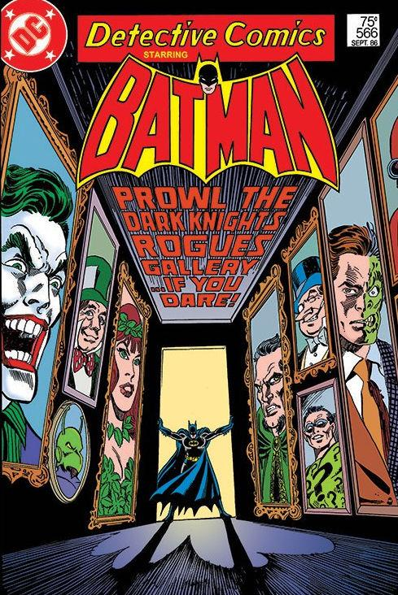
Fin
Questions?

